Slide 1
Travel management system

Slide 2
contents
Introduction to travel management system
frontend: Thymeleaf ,html, CSS,
Backend: Spring boot, java
Technologies use
Objective
Requirements
Screenshorts
Page1 : home page

Slide 3
contents
Page2: contact us
Page 3: Booking
Page 4: about
Advantages
Conclusion

Slide 4
Introduction
The rapid advancement of internet based technology, online booking services has come as a great relief to most travellers. Most travelling agencies as well as other companies that are engaged in travelling business now have on their website online ticket booking portals. From this web page one can easily book and pay for tickets online. Travel management system (TMS) is an online system which utilizes the advantages of the internet to provide travel services ranging from tickets on conveyance and hotel booking for customers from their homes. TMS provides a simple web interface to make the travel request and services booking process easy. All users have access to a web form to book their travel in a few mouse clicks.

Slide 5
Frontend
Thymeleaf is a Java library that is open-source and licensed under the Apache License 2.0. It's a template engine that supports HTML5, XHTML, and XML. It's a Java template engine that works in web and non-web environments. It's ideal for HTML5 JVM web development today.
Thymeleaf is a Java library, template engine used to parse and render the data produced by the application to template files – thus providing transformation. It is just like HTML but is provided with more attributes for working with rendered data. It allows caching of the parsed data/file to increase efficiency while at production. Types of templates it can process are – HTML, JAVASCRIPT, CSS, XML, TEXT, RAW.

Slide 6
Frontend
Thymeleaf is a modern server-side Java template engine for both web and standalone environments, capable of processing HTML, XML, JavaScript, CSS, and even plain text.
The main goal of Thymeleaf is to provide an elegant and highly-maintainable way of creating templates.
It's commonly used to generate HTML views for web apps.
Thymeleaf template engine is commonly used with the Spring MVC framework to develop web applications.

Slide 7
THYMELEAF ATTRIBUTES
A few important Thymeleaf attributes are:
Thymeleaf th:text attribute
Thymeleaf th:each attribute
Thymeleaf th:if and th:unless attribute
Thymeleaf th:switch and th:case attribute
Thymeleaf th:fragment attribute.

Slide 8
Hyper Text Markup Language
HTML is an acronym which stands for Hyper Text Markup Language(HTML) which is used for creating web pages and web applications. Let's see what is meant by Hypertext Markup Language, and Web page.
Hyper Text: HyperText simply means "Text within Text." A text has a link within it, is a hypertext. Whenever you click on a link which brings you to a new webpage, you have clicked on a hypertext. HyperText is a way to link two or more web pages (HTML documents) with each other.

Slide 9
Hyper Text Markup Language
Markup language: A markup language is a computer language that is used to apply layout and formatting conventions to a text document. Markup language makes text more interactive and dynamic. It can turn text into images, tables, links, etc.
Web Page: A web page is a document which is commonly written in HTML and translated by a web browser. A web page can be identified by entering an URL. A Web page can be of the static or dynamic type. With the help of HTML only, we can create static web pages

Slide 10
Cascading Style Sheets
Cascading Style Sheets (CSS) is a style sheet language used for describing the presentation of a document written in a markup language such as HTML or XML (including XML dialects such as SVG, MathML or XHTML).[1] CSS is a cornerstone technology of the World Wide Web, alongside HTML and JavaScrip.
CSS is designed to enable the separation of content and presentation, including layout, colors, and fonts.[3] This separation can improve content accessibility; provide more flexibility and control in the specification of presentation characteristics.

Slide 11
BACKEND: SPRING BOOT
Creating Spring Boot using spring boot initializer.
Spring Boot provides a good platform for Java developers to develop a stand-alone and production-grade spring application that you can just run. You can get started with minimum configurations without the need for an entire Spring configuration setup.
Spring Boot is designed with the following goals −
To avoid complex XML configuration in Spring
To develop a production ready Spring applications in an easier way

Slide 12
BACKEND: SPRING BOOT
To reduce the development time and run the application independently
Offer an easier way of getting started with the application.
Dependencies that added in my project are:
Spring web
Thymeleaf
SpringData jpa
MYSQL Database
Webtools

Slide 13
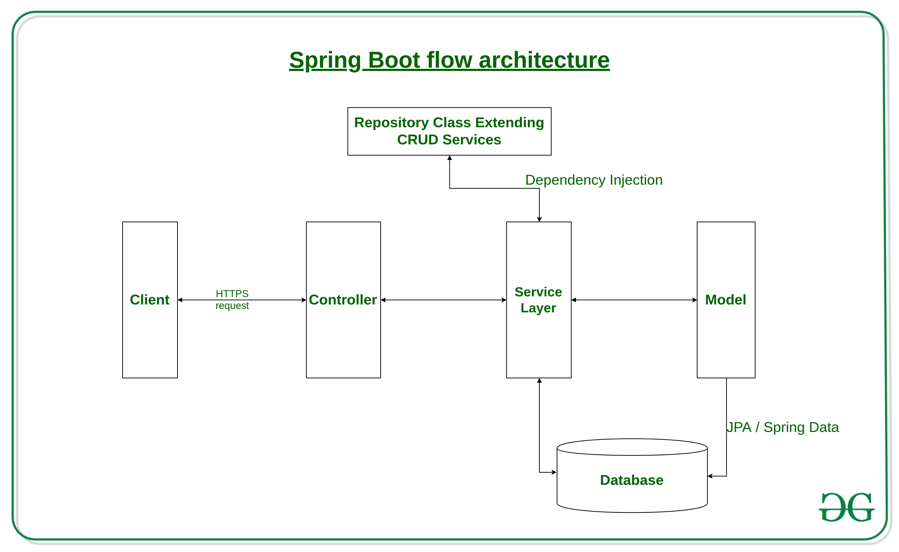
Spring boot architecture

Slide 14
BACKEND : JAVA
Java is a high-level, class-based, object-oriented programming language that is designed to have as few implementation dependencies as possible. It is a general-purpose programming language intended to let programmers write once, run anywhere (WORA),[17] meaning that compiled Java code can run on all platforms that support Java without the need to recompile.[18] Java applications are typically compiled to bytecode that can run on any Java virtual machine (JVM) regardless of the underlying computer architecture. The syntax of Java is similar to C and C++, but has fewer low-level facilities than either of them. The Java runtime provides dynamic

Slide 15
BACKEND : JAVA
capabilities (such as reflection and runtime code modification) that are typically not available in traditional compiled languages. As of 2019, Java was one of the most popular programming languages in use according to GitHub,particularly for client–server web applications, with a reported 9 million developers.
Java was originally developed by James Gosling at Sun Microsystems. It was released in May 1995 as a core component of Sun Microsystems' Java platform

Slide 16
Technologies used
The Technology used in this Project is :-
Eclipse platform (Frontend And Backend)
Thymeleaf, HTML and CSS for frontend
JAVA ,Spring Boot for Backend
Mysql
Bootstrap

Slide 17
objective
Our objective is to offer a variety of travel services that are sure t match all your priorities.
Our objective is to globalism, organize, standardize and goal of journey towards perfectionism.
Our objective is to make strong relationship with customers so that they can enjoy the holiday of their dreams.
Our objective is just an initiative, it will be made to more further and developed work of art.

Slide 18
requirements
Hardware requirements:
Processor – i3
Hard Disk- 8GB
Software requirements:
Window 11
Mysql work bench
Eclipse 2022

Slide 19
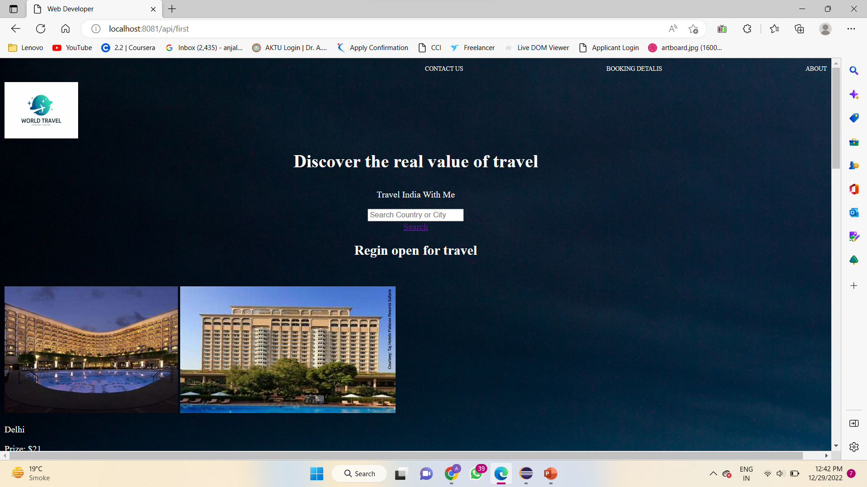
HOME PAGE
This is the Main page of this website.
In this page we have used HTML and CSS for designing.
We have 4 Buttons.
Booking Details button is connected to the Database.

Slide 20
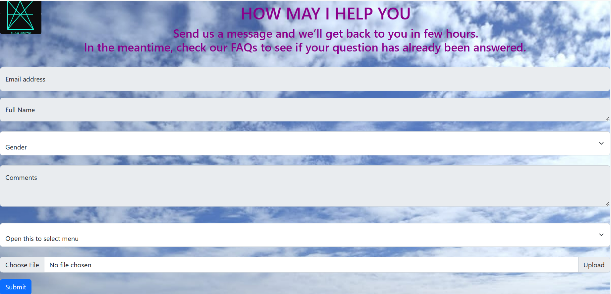
Contact us
When we click on to CONTACT US Button then this page flashes.
On this page we have a form.
The Contact information.

Slide 21
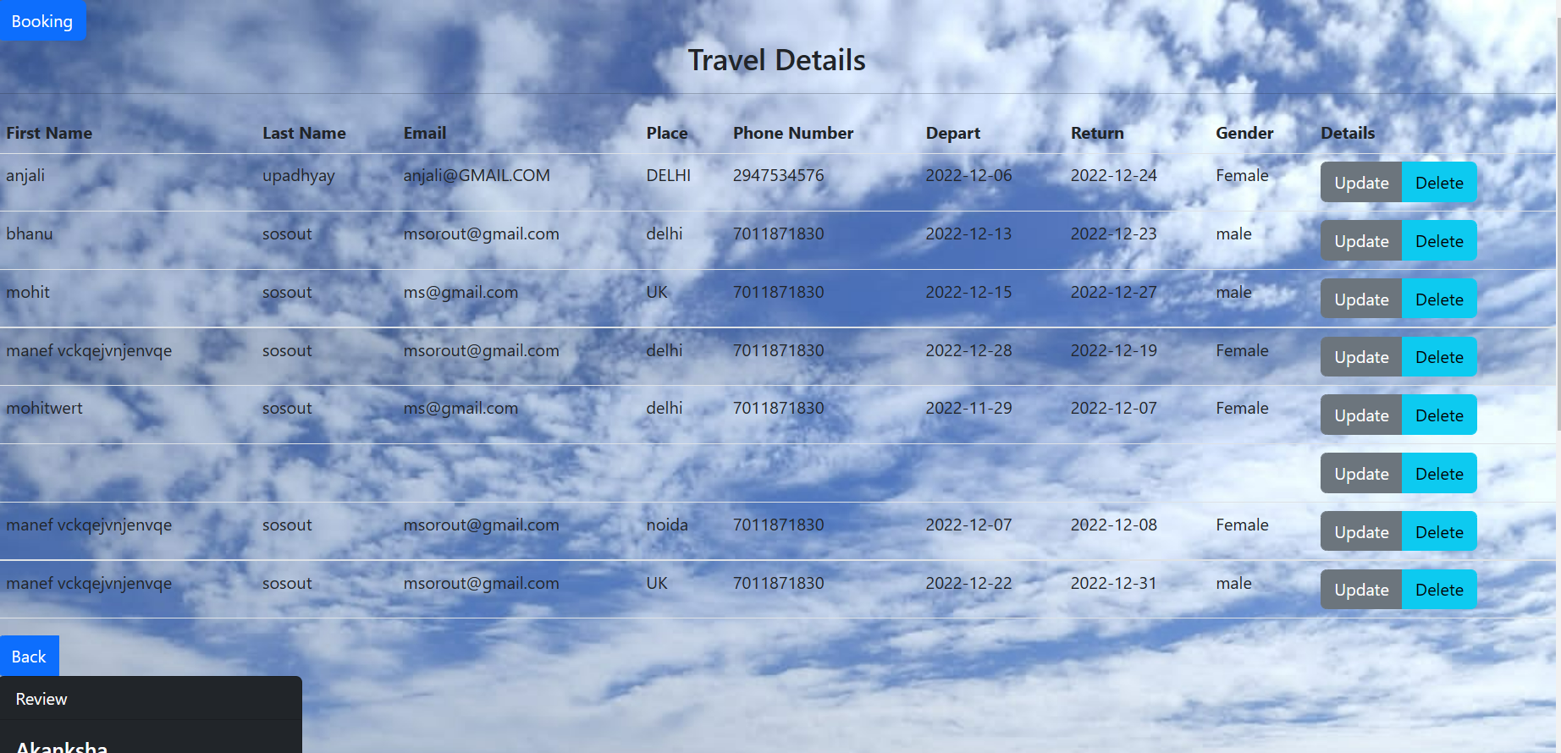
Booking details
When we click on to the BOOKING DETAILS Button then this page flashes.
This page is Connected with Database.
We have a Traveling Details table which show the added people’s details.
We have a booking button which has a form to add the details in the travel table.

Slide 22
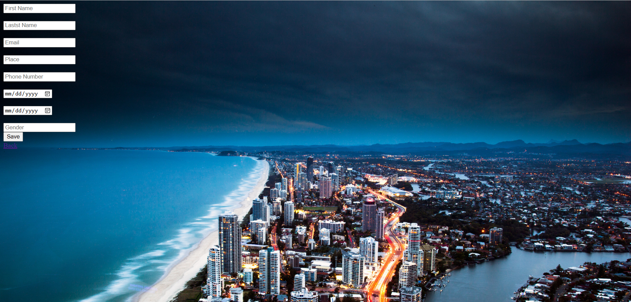
booking
When we click on to BOOKING Button then this page flashes.
When we click on to the Save button then it get saved in the database and show in the travel details table.
The travel table has update and delete button .

Slide 23
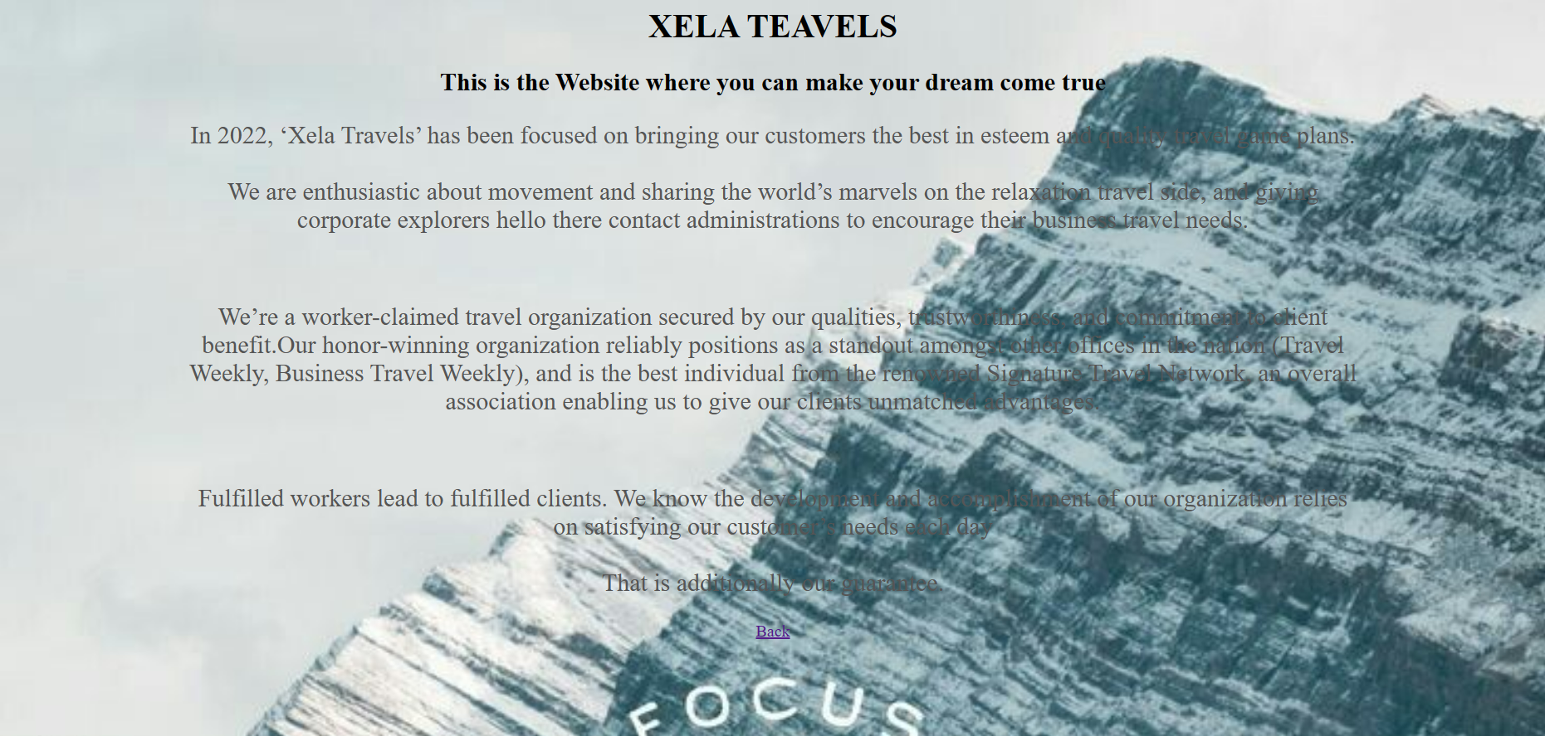
about
When we click on to ABOUT Button then this page flashes.
This is the description of the XELZ travel WEBSITE.

Slide 24
advantages
Make huge cost savings
Reduce carbon footprint
Improve the efficiency of your planning
Make savings wherever you can in places you may not have realized.
Benefit from the knowledge of travel experts.

Slide 25
conclusion
Online Travel Management system is a web-based application that allows travelers check for booking a hotel . Travel management system is presently in use which involved the use of papers for
storing traveller’s information. With this method there is always long queue, loss of data,incomplete traveller’s information and inaccuracy. An online Travel management system was implemented for Faith to solve the existing problems. Tools such as MySQL,Thyemeleaf server were used to develop the online travel management system

Slide 26
Thank you

